Slide 1
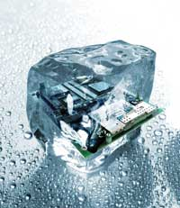
A gentle introduction to Autotools
The good, the bad and the ugly
Kees-Jan Dijkzeul
October 28th, 2010

Slide 2
Contents
Intro
  Me
  You
  Autotools
Autotool goals
The tools
  Autoconf
  Automake
  LibTool
Conclusions

Slide 3

Who am I, and why am I here
Kees-Jan Dijkzeul
  Software designer at
  Sioux Embedded Systems
    Co-chair of the Linux SIG
  Using Linux since 1994
  Writing embedded software since
  1998

Slide 4
Who am I, and why am I here (2)
Mostly writing Makefiles by hand
But for my latest pet project, I
needed something more substantial
I randomly picked autotools

Slide 5
Mandatory commercial slide
Sioux Embedded Systems
  Domain: Embedded Systems & Technical Automation
  Machine Control, Medical Systems, Automotive, Consumer Electronics
  Software & electronics development
  Development Centre Projects: fixed price and risk reward
  Partnering in product development
  Platform product: Machine2World®: remote monitoring & control
  BinC – Be in Control: integrated security solutions for businesses and consumers
  Consulting and assessments: software process, system architecture

Slide 6
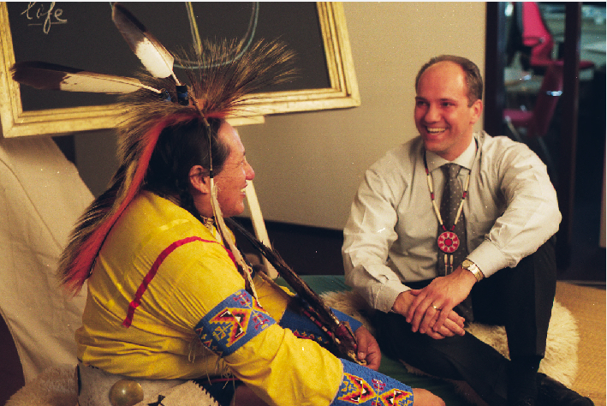
Mandatory commercial slide
Notes:
Kelly Looking Horse (full blooded Lakota)

Slide 7
Who are you and why are you here?
You've heard of the autotools, and know what it is supposed to do
You've (accidentally) opened a configure.am or a Makefile.ac or whatever
Possibly Autotools blew up in your face

Slide 8

What are autotools?
“The GNU build system, also known as the Autotools, is a suite of programming tools designed to assist in making source-code packages portable to many Unix-like systems”
  – Wikipedia

Slide 9
Autotools opinions
“The developer has to use (and learn) syntaxes for the combo of automake + autoconf + libtool + make + sh + perl + m4”
“So […] there is the opinion that dealing with the build system is hard, almost higher magic. This is a myth. A myth created by autotools.”
Alexander Neundorf – Why the KDE
project switched to CMake

Slide 10
There's praise also...
“[…] that autoconf and automake permit substantial end-user adjustment. [...] Most alternative build systems throw all of that away and provide very little alternative”
“Autoconf also embodies a lot of 'ancient wisdom' about detection of features available on all sorts of systems. I haven't found *any* other build systems that come close.”

Slide 11

Moving from Makefiles to autotools
Moving from Makefiles to autotools is like learning a new, powerful, language
  You can do in a single line what used to take pages of coding
  If you don't understand what the system is trying to do for you under the hood, you can shoot yourself in the foot badly
  If you don't like what the system is doing for you, you're using the wrong tool

Slide 12





So what is autotools trying to do?
Developer System
User System
Source code
  ./configure
  make
  sudo make install
Notes:
Autotools is not trying to make the life of software developers easier
Autotools is trying to make the life of package maintainers/software installers easier.
By providing a standard interface (GNU coding standards)
./configure && make && sudo make install
(Some) standard options, standard make targets, standard installation locations
Still assumes well-written, tested software

Slide 13
So what is autotools trying to do?
Portability is key
  Correctly detect features of many target platforms
    Enable the software to adapt to the platform using #ifdefs
  Provide a common abstraction for shared libraries
  Alleviate the drudgery of writing Makefiles

Slide 14
Contents
Intro
  Me
  You
  Autotools
Autotool goals
The tools
  Autoconf
  Automake
  LibTool
Conclusions

Slide 15

Autoconf
Goal: Generate a configure script that
  Detects the system features required by your program
  Allows the user to configure your program
Writing configure scripts by hand is error prone and no fun at all

Slide 16
Autoconf
configure.ac
configure
config.log
autoconf
autoheader
Shell script
with
M4 macros
Pure
shell script
config.h.in
config.status
config.h
Makefile.in
*.in files
contain
placeholders
Placeholders
replaced
with values
Makefile.in
Makefile
Makefile

Slide 17
Autoconf
There's already a lot of tools involved
And they have to be called in the correct order!
autoreconf
Only edit the green files! The rest is generated!

Slide 18
Autoconf
Demo

Slide 19
Autoconf – wrap up
Autoconf helps you write a configure script to configure your software
The Makefile.in consists of mostly boilerplate
  We shouldn't have to write that stuff

Slide 20
Contents
Intro
  Me
  You
  Autotools
Autotool goals
The tools
  Autoconf
  Automake
  LibTool
Conclusions

Slide 21
Automake
configure.ac
configure
config.log
autoconf
autoheader
config.h.in
config.status
config.h
Makefile.in
Makefile
Makefile.in
Makefile

Slide 22
Automake
configure.ac
configure
config.log
autoconf
autoheader
config.h.in
config.status
config.h
Makefile.am
Makefile.in
Makefile
automake
Makefile++
Makefile +
placeholders
pure
Makefile

Slide 23
Automake
Demo

Slide 24
Automake – wrap up
Automake generates Makefiles
  For building your project
  For testing your project
  For creating tarballs for distributing your project
So how do I portably build shared libraries?

Slide 25
Contents
Intro
  Me
  You
  Autotools
Autotool goals
The tools
  Autoconf
  Automake
  LibTool
Conclusions

Slide 26
LibTool
configure.ac
configure
config.log
autoconf
autoheader
config.h.in
config.status
config.h
Makefile.am
Makefile.in
Makefile
Makefile.am
Makefile.in
Makefile
automake

Slide 27
LibTool
configure.ac
config.h.in
config.status
config.h
Makefile.am
Makefile.in
Makefile
Makefile.am
Makefile.in
Makefile
automake
ltmain.sh
libtool
libtool
Shell script,
part of
autotools
Wraps
compiler and
linker

Slide 28
LibTool
Demo

Slide 29
Let's jump to conclusions

Slide 30
configure.ac
configure
config.log
Autoconf
autoheader
config.h.in
config.status
config.h
Makefile.am
Makefile.in
Makefile
Makefile.am
Makefile.in
Makefile
automake
ltmain.sh
libtool
libtool

Slide 31
Conclusions
I never realized so much work went into getting your software to run on someone else's machine.
I like the experience I'm providing for my users
I'm not so happy about the amount of effort on my part
Notes:
Autotools have a steep learning curve (and I'm not there yet)
“Do one thing and do it well”
Forward and backward compatability are suboptimal

Slide 32
Resources
Autotools: A practitioner's guide
  on-line version
  paper version
Wikipedia
GNU coding standards
Why the KDE project switched to CMAKE
Did you call them Autocrap tools?
Scroom, the pet project that started all this
Notes:
On-line book by John Calcote
“Why the KDE project switched” by Alexander Neundorf
“Autocrap” by Poul Hennings (Varnish)

Slide 33
Famous last words
Don't fight the system
autoreconf [-i]
Only edit the green files! The rest is generated!

Slide 34
Questions?

Slide 35




Source of your development.
www.sioux.eu
kees-jan.dijkzeul@sioux.eu
+31-40-2677100

Slide 36
Developer System
User System
configure.ac
configure
config.log
Autoconf
autoheader
config.site
config.cache
config.h.in
config.status
config.h
Makefile.am
Makefile.in
Makefile
Makefile.am
Makefile.in
Makefile
automake
ltmain.sh
libtool
libtool

Slide 37
config.cache
The configure script optionally caches the results of its tests
  Convenient if you are debugging a lengthy configure script
  Convenient when installing many packages with similar configuration

Slide 38
config.site
Before starting, the configure script reads a config.site file (if present)
  May contain arguments to ./configure
  May contain test results
Be careful not to override user-specified values
test "$prefix" = NONE && prefix=/usr/share/local/gnu

